Slide 1
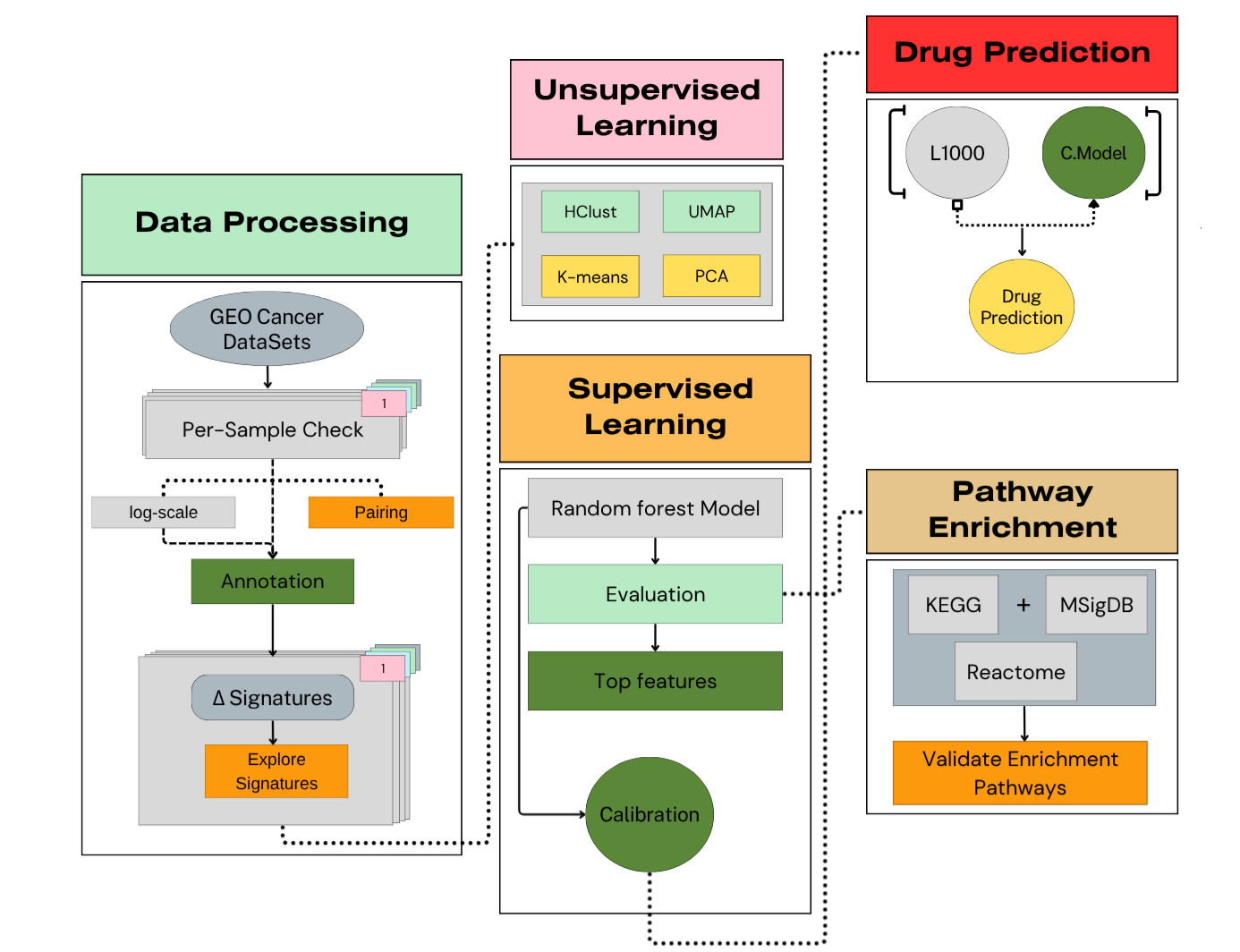
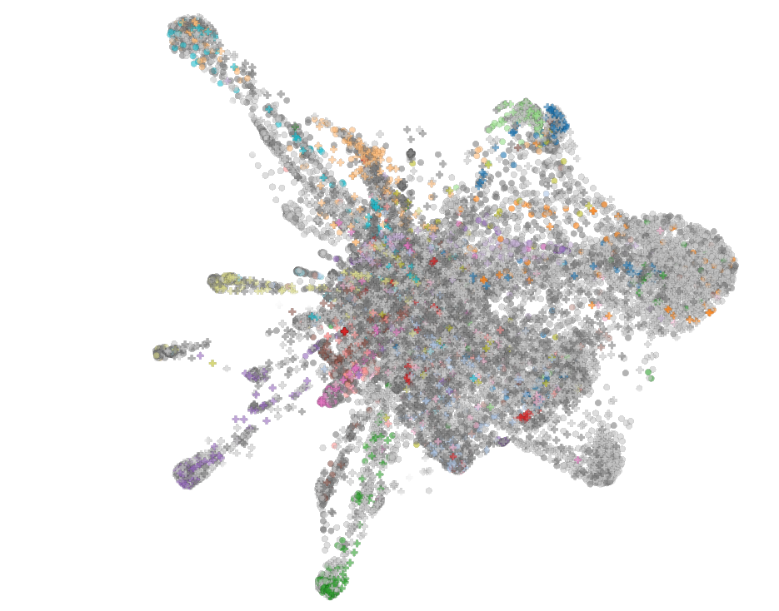
Reversing Tumor–Normal Expression Differences with L1000 Drug Signatures
Georgios Kousis Tsampazis
BC203
https://github.com/geokousis/BCProjects

Slide 2
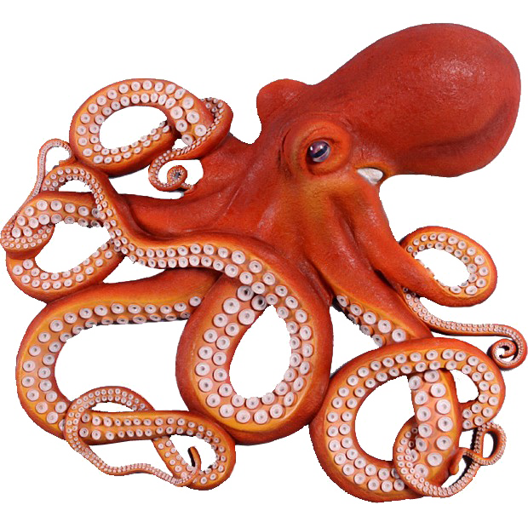
Reversing Tumor–Normal Expression Differences with L1000 Drug Signatures

Slide 3

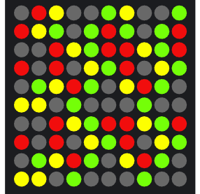
Reversing Tumor–Normal Expression Differences with L1000 Drug Signatures
Time exposure
Concentration
Cell lines
(Luminex bead–based assay)
Compound
978
Cell line expression
Treated-Cell line expression
L1000sig = Treated-Cell line expression - Cell line expression
(Subramanian et al., 2017)

Slide 4


Reversing Tumor–Normal Expression Differences with L1000 Drug Signatures
Cell line X Treated with Compound X
L1000sig
TP53
EGFR
TNF
APOE
IL6
VEGFA
MTHFR
ADCY5 AGPAT2 AGTR1
-10
+10

Slide 5


Reversing Tumor–Normal Expression Differences with L1000 Drug Signatures
Paired Sampling
Cell line X Treated with Compound X
L1000sig
Tumorsig
TP53
EGFR
TNF
APOE
IL6
VEGFA
MTHFR
ADCY5 AGPAT2 AGTR1
TP53
EGFR
TNF
APOE
IL6
VEGFA
MTHFR
ADCY5 AGPAT2 AGTR1
-10
+10
Tumorsig = Tumor expression – Normal expression

Slide 6
Reversing Tumor–Normal Expression Differences with L1000 Drug Signatures
Tumorsig
L1000sig
TP53
EGFR
TNF
APOE
IL6
VEGFA
MTHFR
ADCY5 AGPAT2 AGTR1
TP53
EGFR
TNF
APOE
IL6
VEGFA
MTHFR
ADCY5 AGPAT2 AGTR1
Compound
L1000sig
Cell line expression
Treated-Cell line expression
Tumorsig
Tumor expression
Normal expression

Slide 7
Reversing Tumor–Normal Expression Differences with L1000 Drug Signatures
Tumorsig
L1000sig
TP53
EGFR
TNF
APOE
IL6
VEGFA
MTHFR
ADCY5 AGPAT2 AGTR1
TP53
EGFR
TNF
APOE
IL6
VEGFA
MTHFR
ADCY5 AGPAT2 AGTR1
L1000sig = Treated-Cell line expression - Cell line expression
Tumorsig = Tumor expression – Normal expression
Carcinogenic
Deltasig = Normal expression – Tumor expression
=-Tumorsig

Slide 8
Reversing Tumor–Normal Expression Differences with L1000 Drug Signatures
Deltasig
L1000sig
TP53
EGFR
TNF
APOE
IL6
VEGFA
MTHFR
ADCY5 AGPAT2 AGTR1
TP53
EGFR
TNF
APOE
IL6
VEGFA
MTHFR
ADCY5 AGPAT2 AGTR1
Treatment
Deltasig = Normal expression – Tumor expression

Slide 9

L1000sig
Deltasig
Deltasig
Model
L1000
Model
Different types of Cancer
Different L1000 signatures
Compound
Time exposure
Concentration
Cell lines
Success
Type of Cancer
Drug

Slide 11
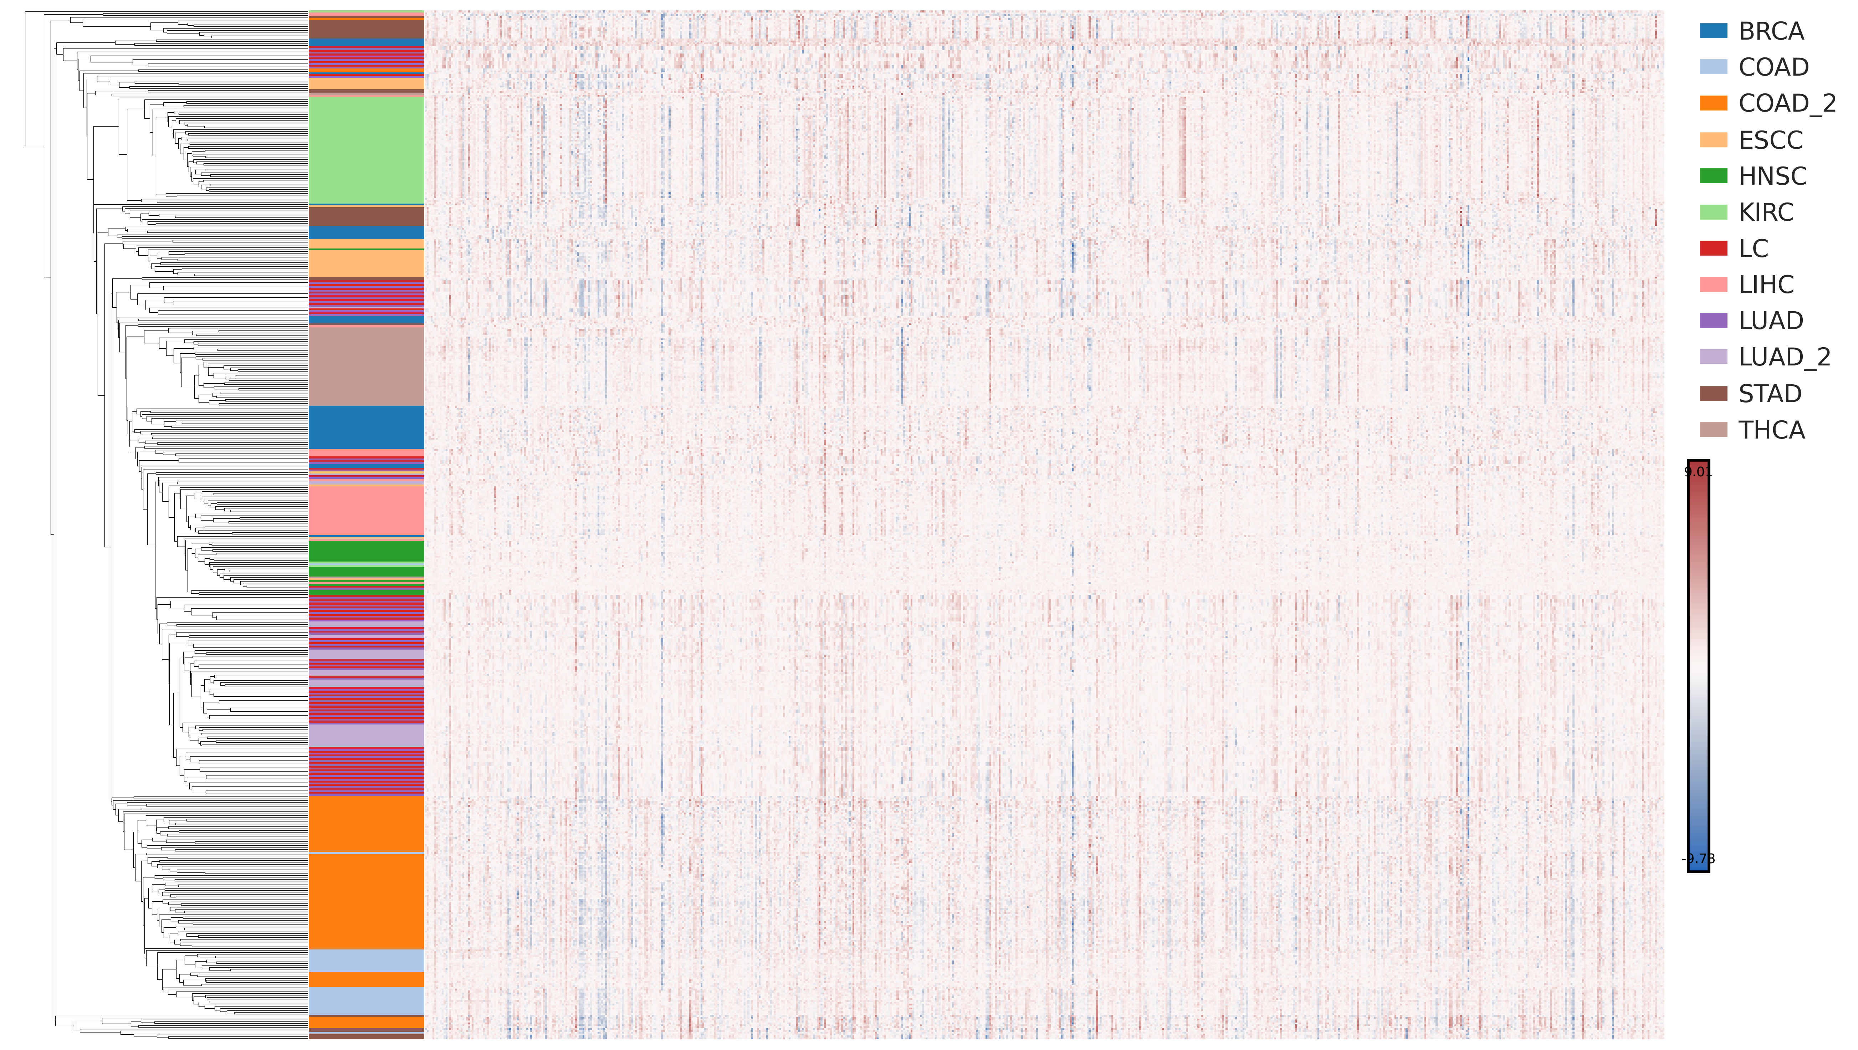
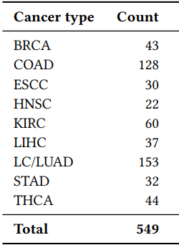
≈700 genes
Notes:
Masto
Paxeos enterou
Isofakou
Lemou kai kefalioi
Nefron
Pneumon
koilias
thiroidi

Slide 12
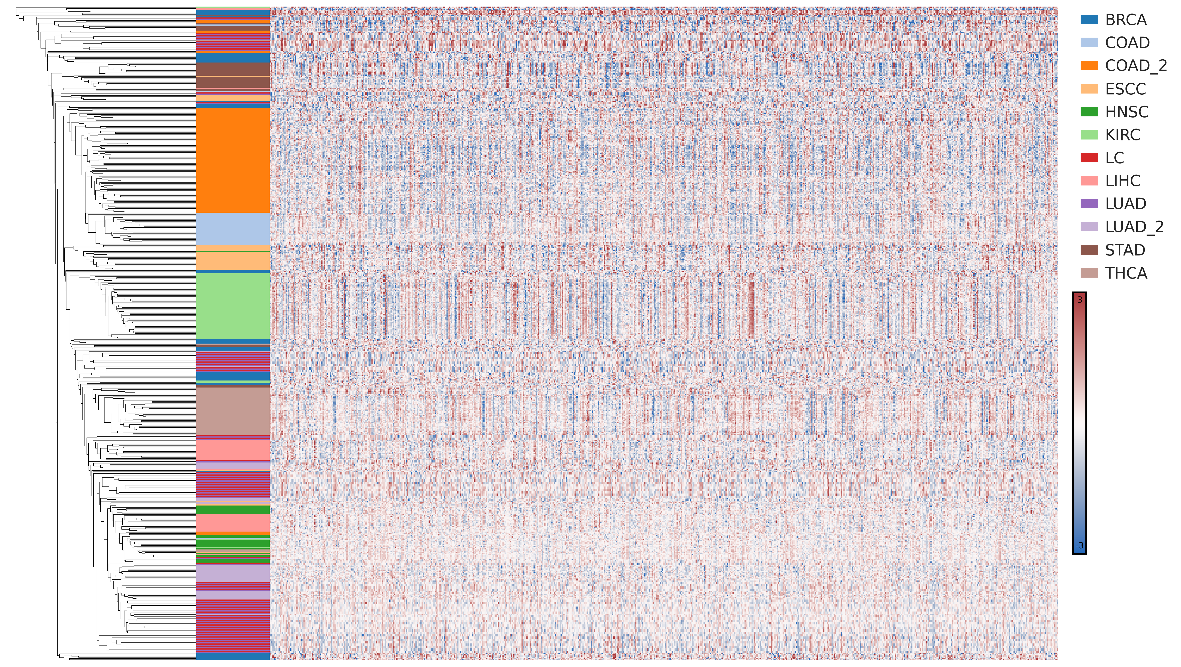

Slide 14
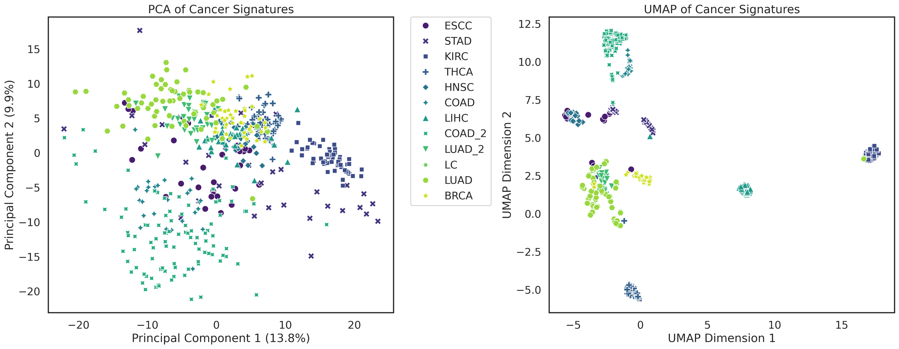
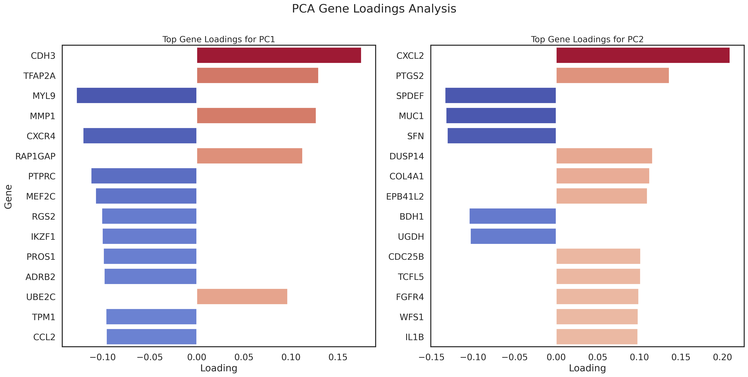

Slide 15
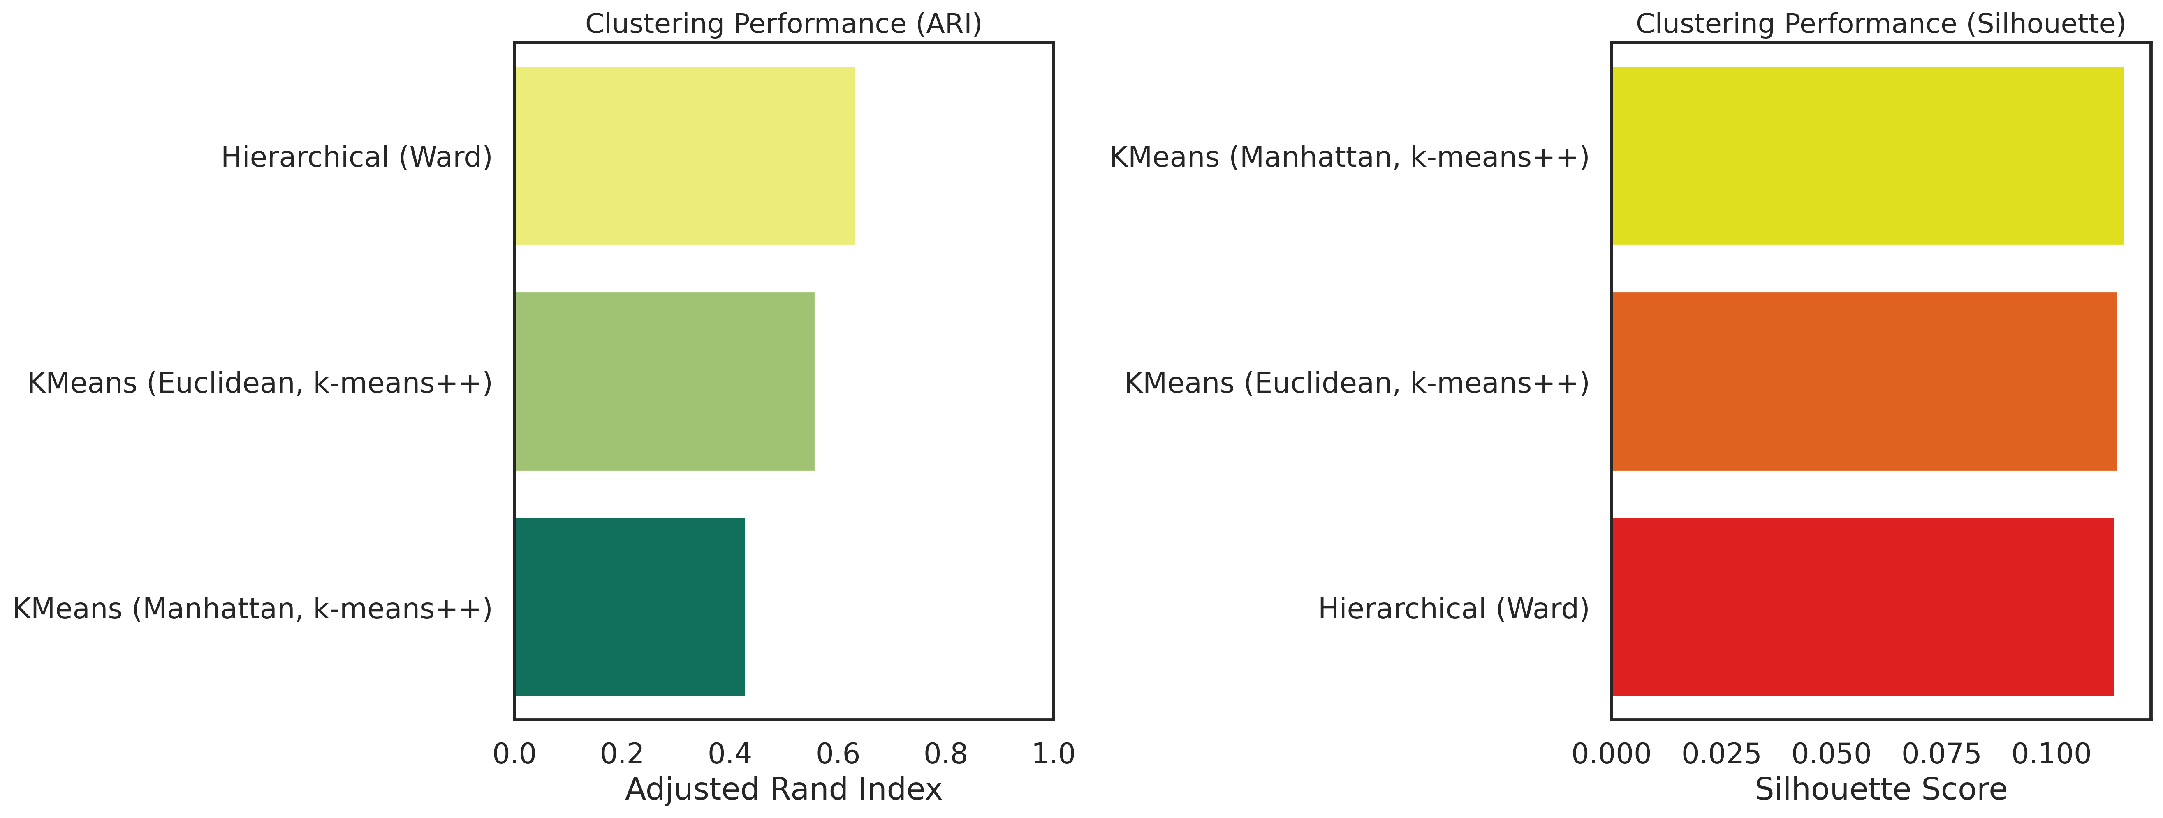

Slide 16
Outer Loop
Testing
Training

Slide 17
Outer Loop
Testing
Training

Slide 18
Outer Loop
Testing
Training
Inner Loop
Testing
Training
Hyperparameter-Tuning

Slide 19
Outer Loop
Testing
Training
Hyperparameters Found
Calibrate Model

Slide 20
Outer Loop
Testing
Training
Hyperparameters Found, Calibrated, Accuracy

Slide 21
Outer Loop
Testing
Training
Hyperparameters Found, Calibrated, Accuracy

Slide 22
Outer Loop
Testing
Training
Hyperparameters Found, Calibrated, Accuracy

Slide 23
Outer Loop
Testing
Training
Hyperparameters Found, Calibrated, Accuracy

Slide 24
Outer Loop
Testing
Training
Hyperparameters Found, Calibrated, Accuracy

Slide 25
Outer Loop
Testing
Training

Slide 26


Slide 27
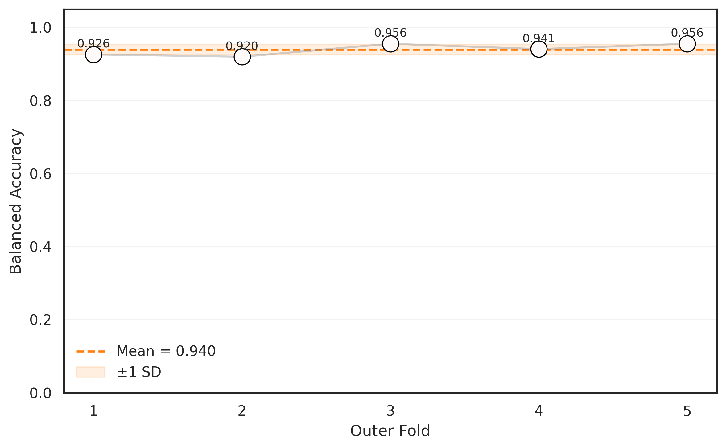

Slide 28
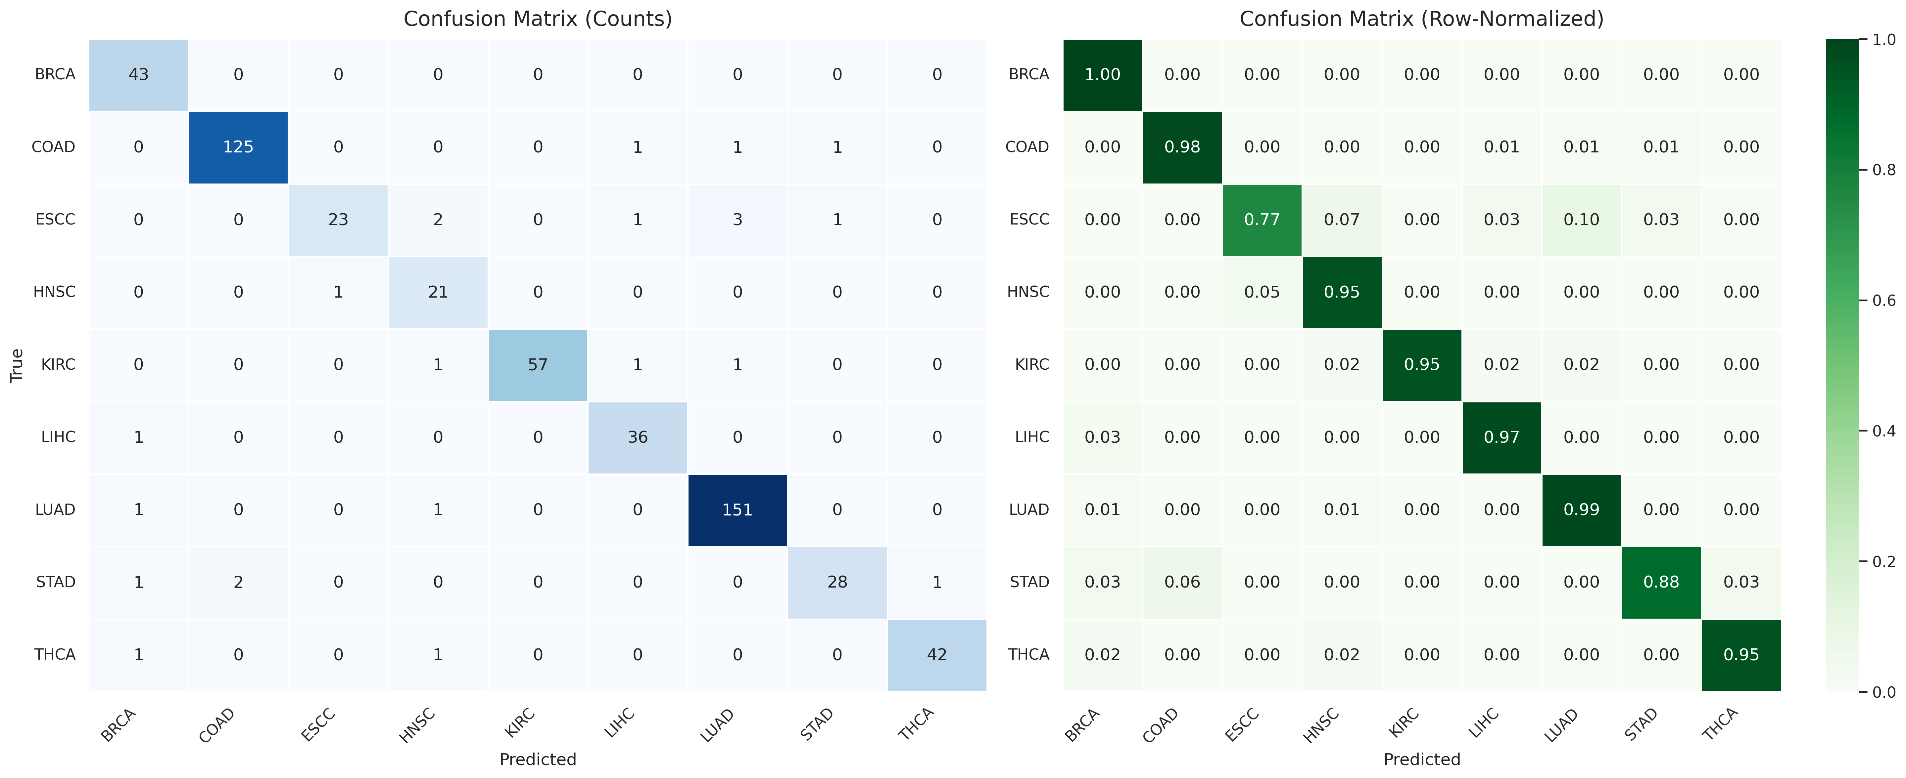
526/549=0.958
8.44/9=0.937

Slide 29
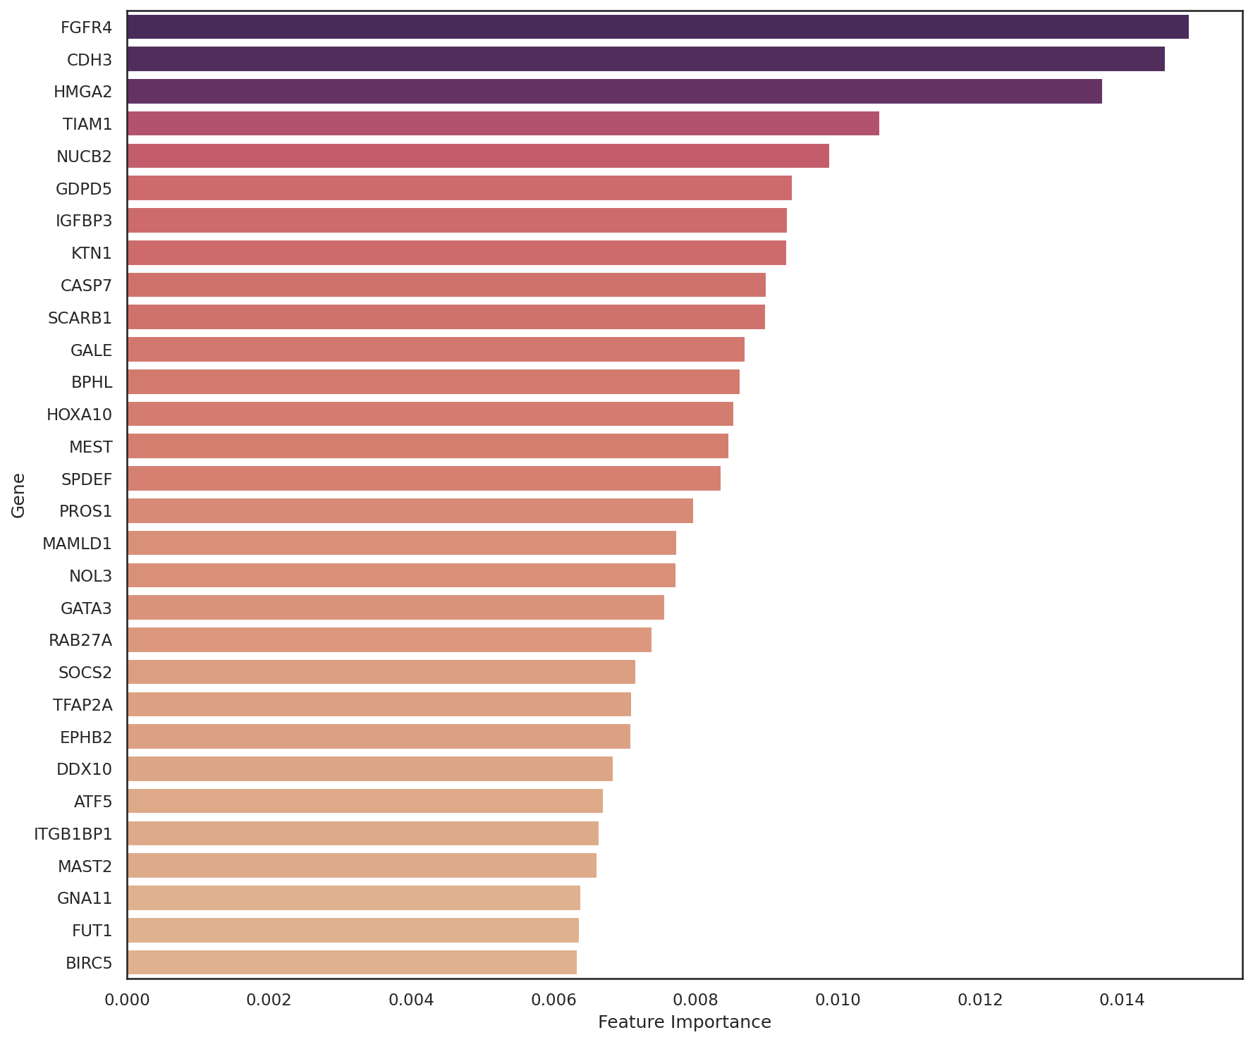

Slide 30
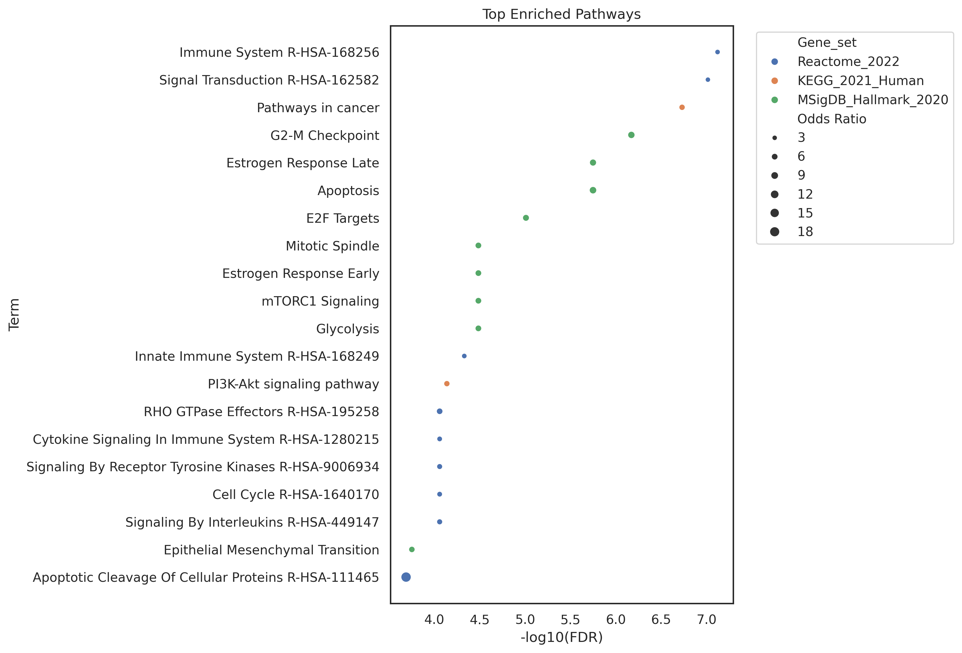

Slide 31
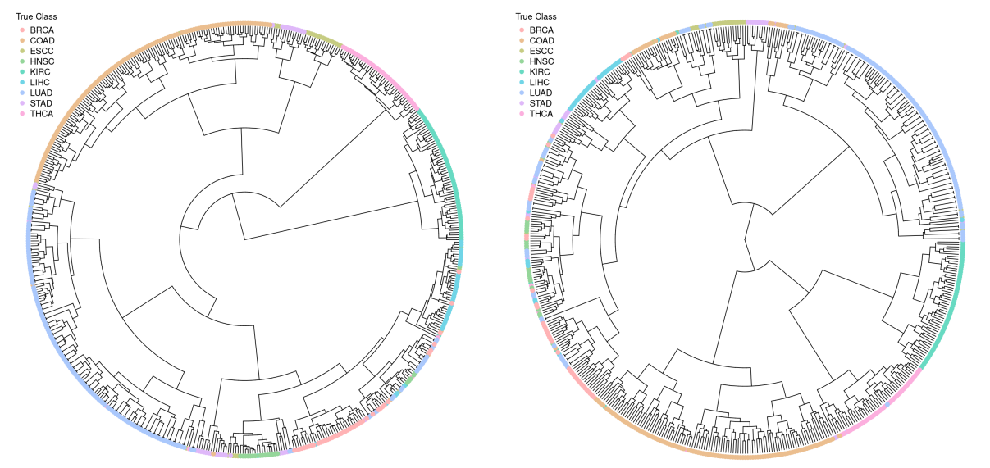

Slide 33
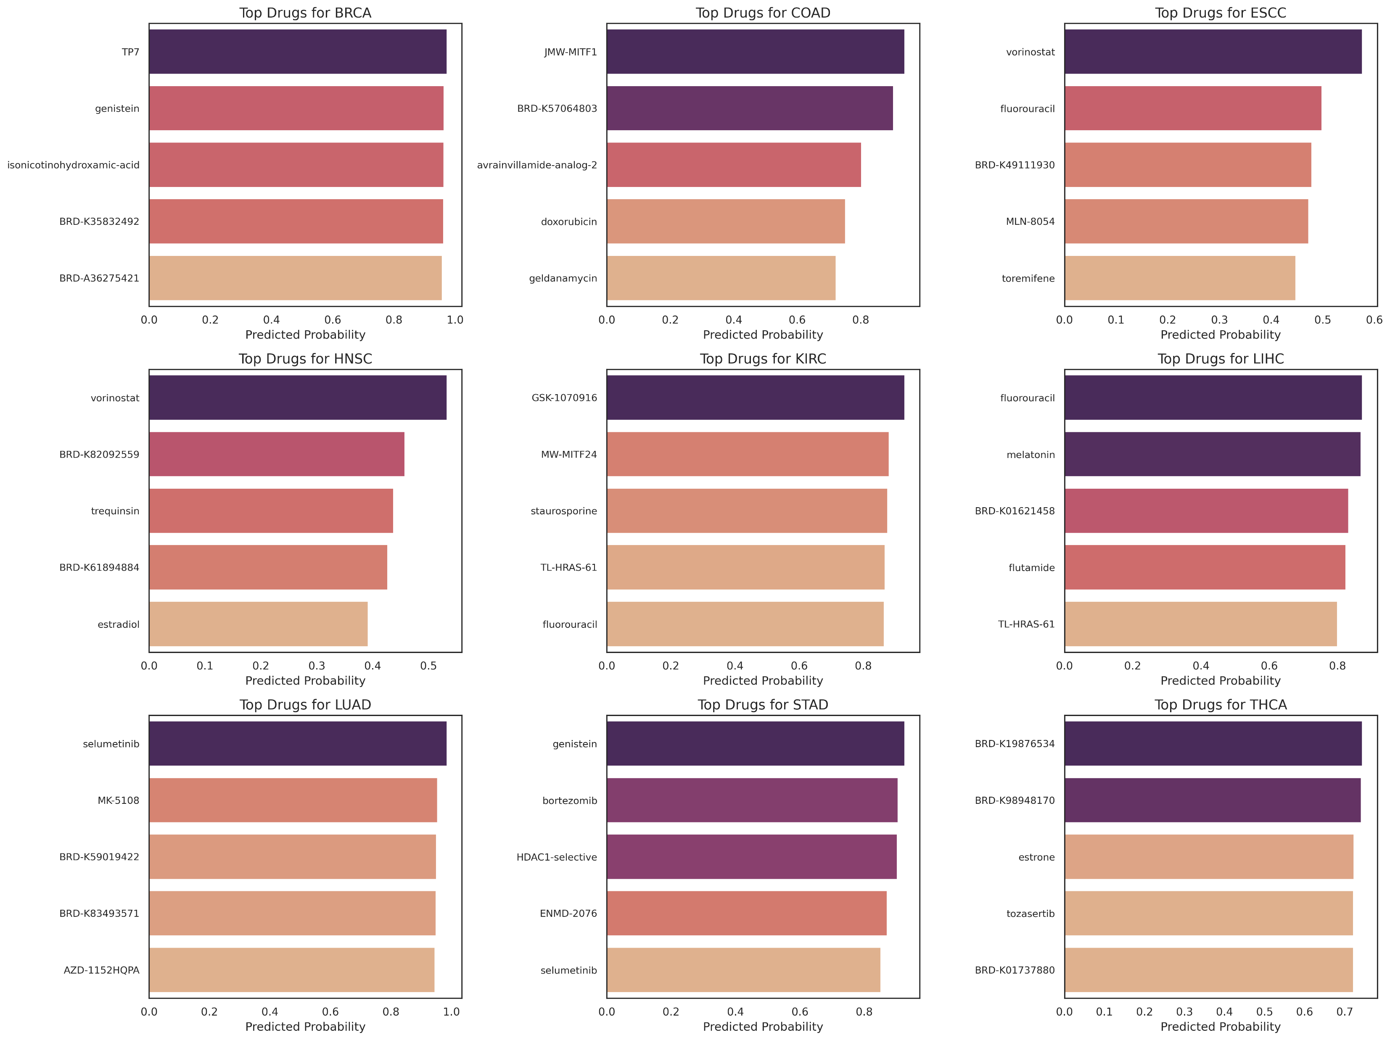

Slide 34
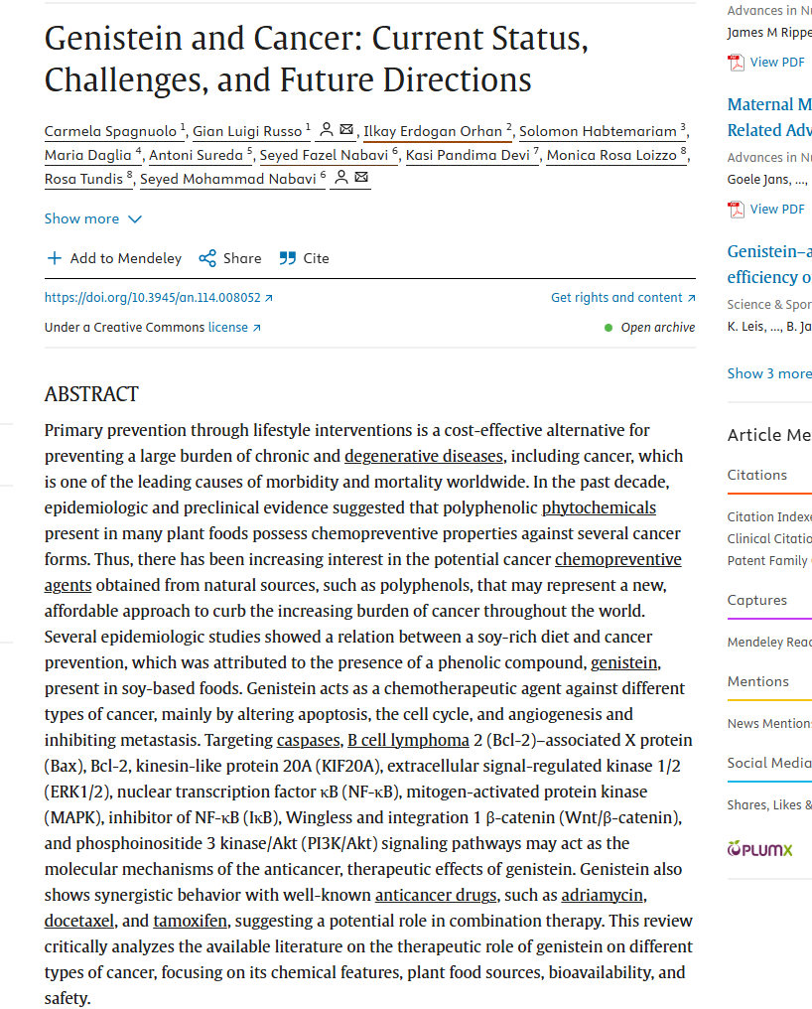

Slide 35
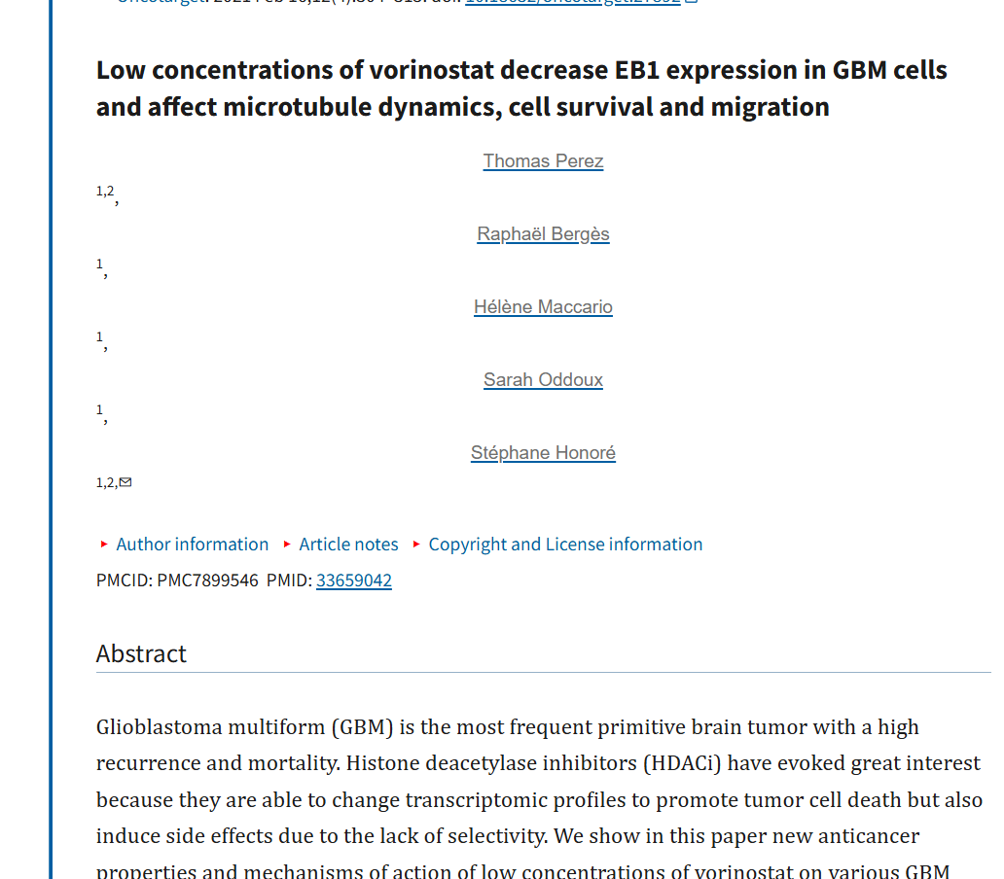

Slide 36
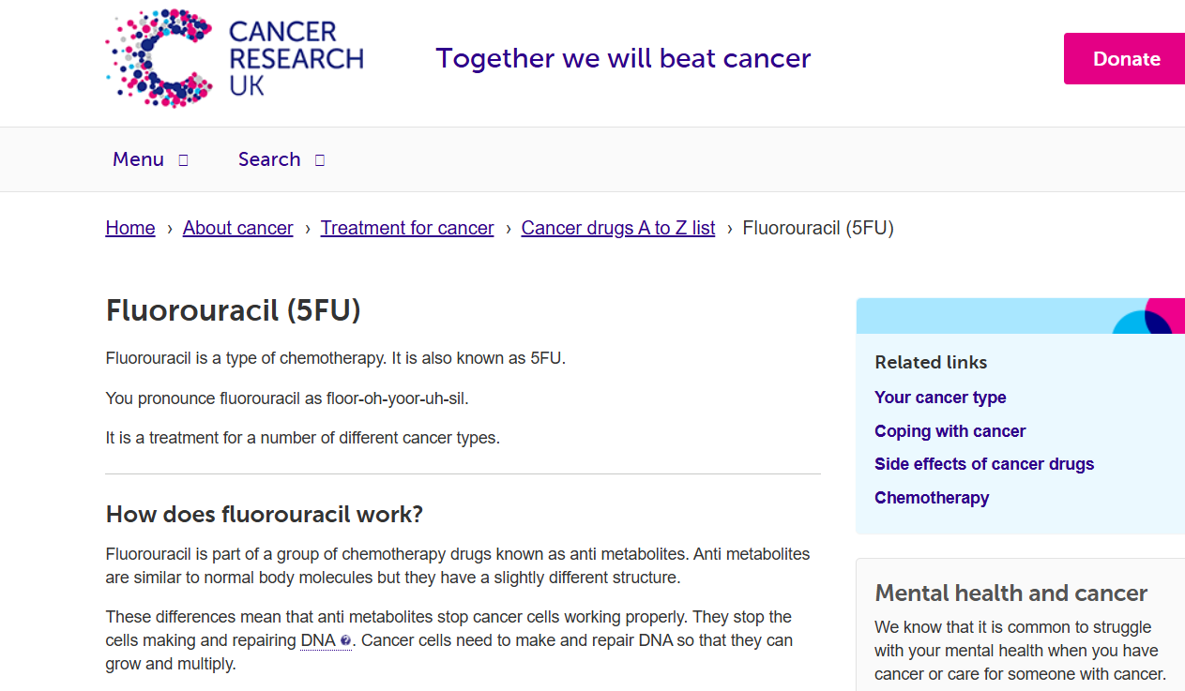
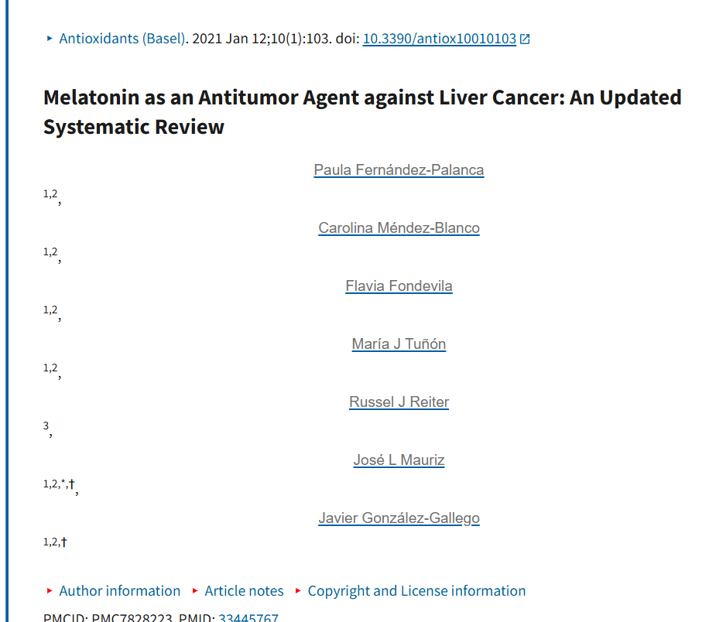

Slide 37
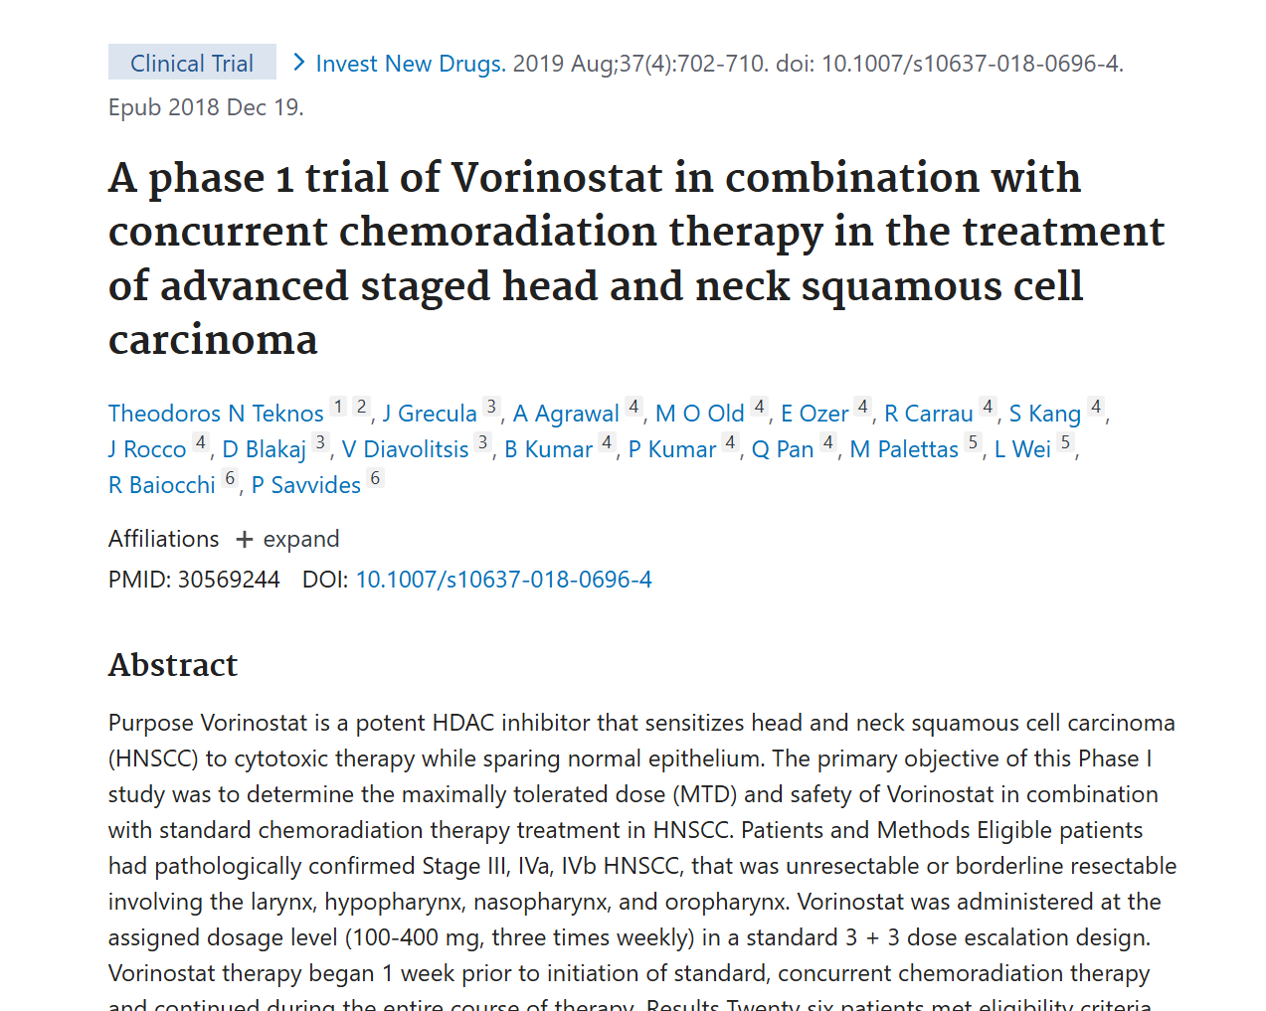

Slide 38
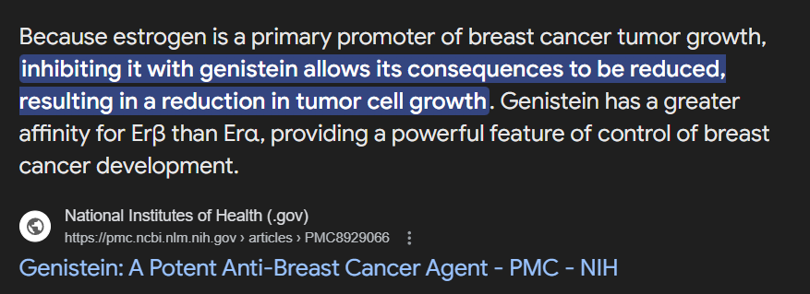

Slide 39
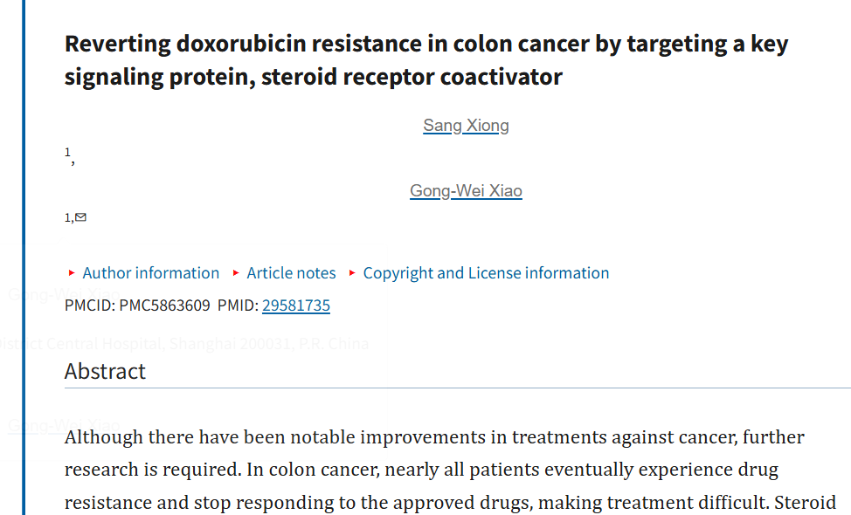

Slide 40


Slide 41
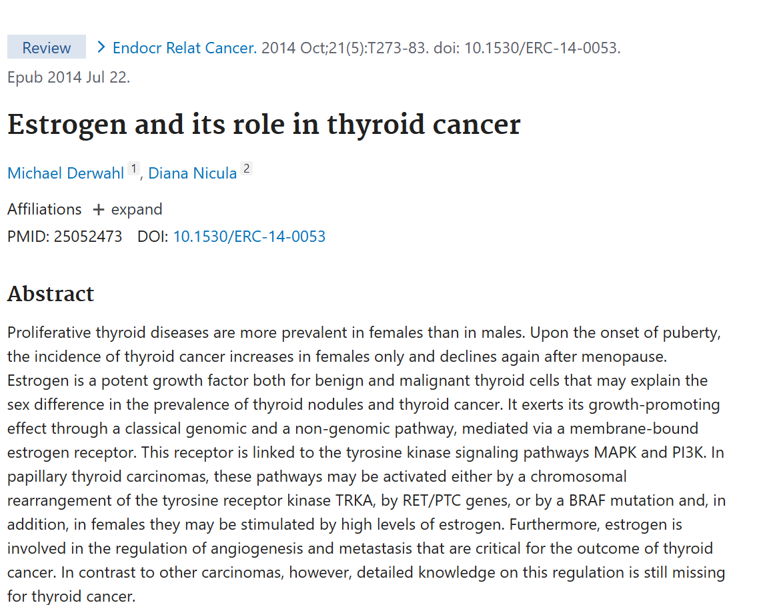

Slide 42
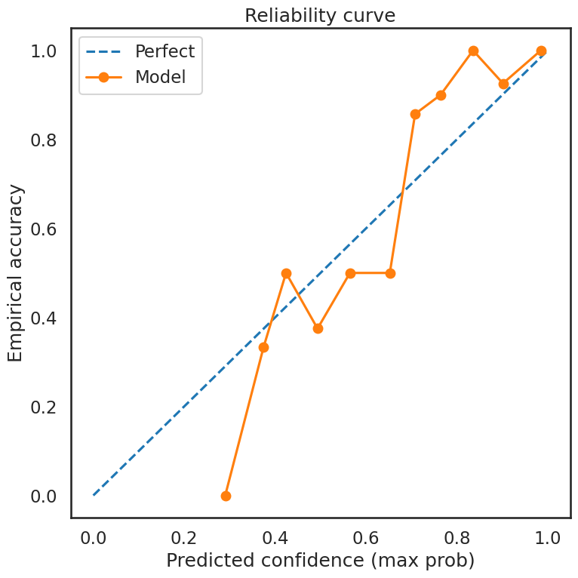

Slide 43
L1000sig
Deltasig
Model
Different types of Cancer
Type of Cancer

Slide 44


Slide 45

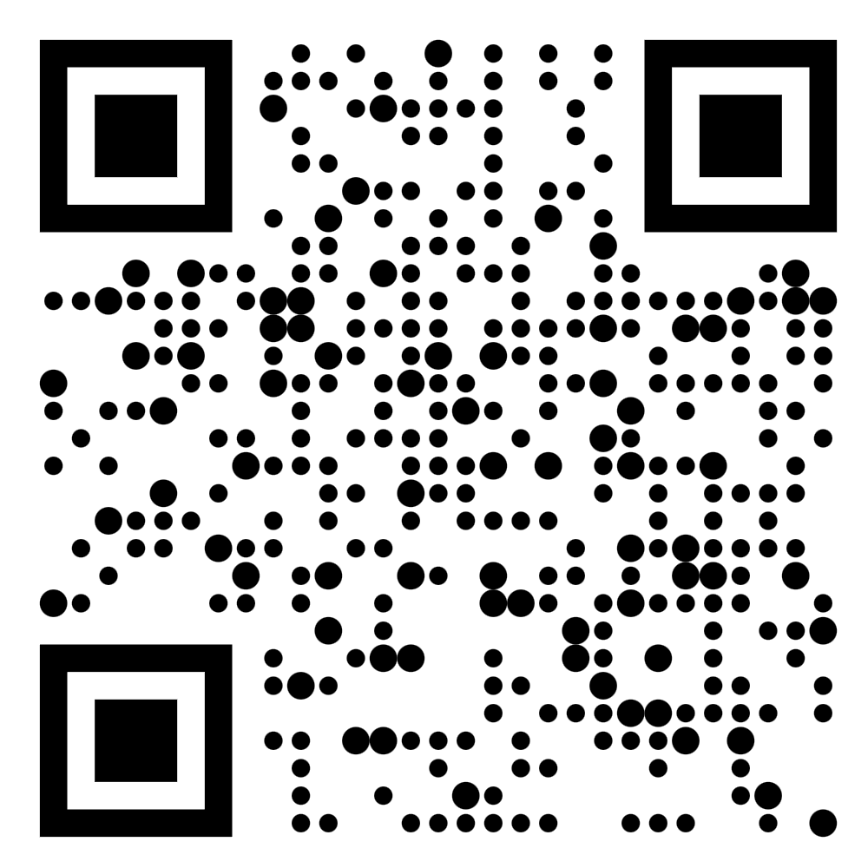


Slide 46
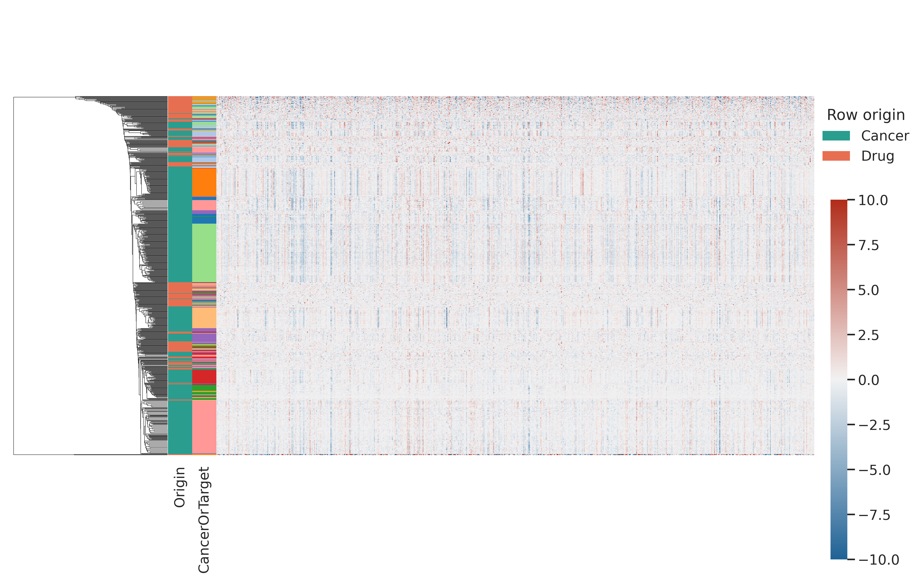

Slide 47
